Slide 1
Innorun
by Lukiyanov Dmitriy Niyaz Gubaidullin Almas Bagishaev
Daniil Tskhe

Slide 2
Problem Statement:
There is no way to store all your running records
There is no way to keep statistics and remember running routes

Slide 3
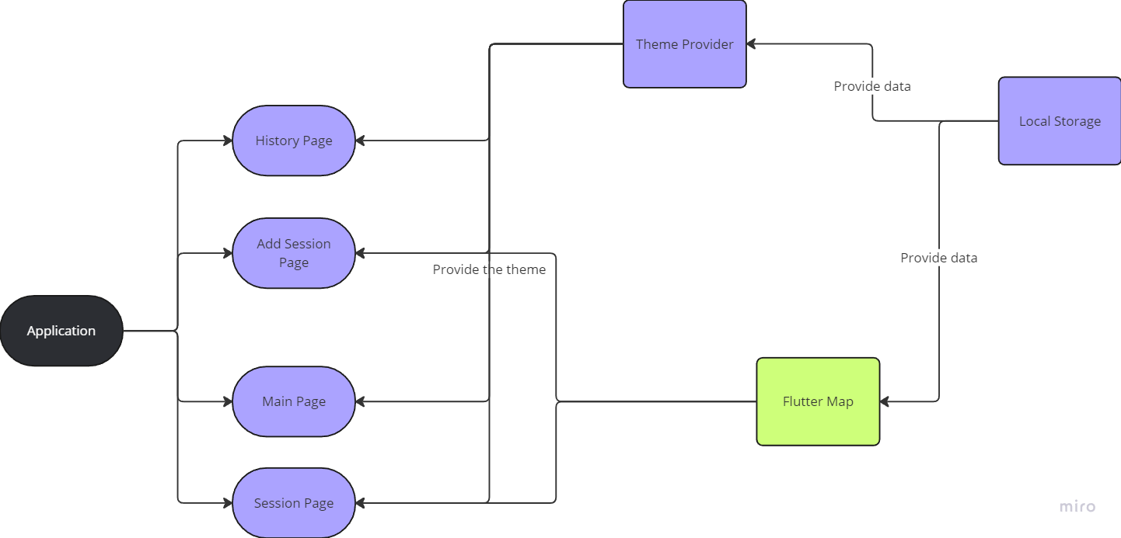
Architecture diagram

Slide 4

ADD Session

Slide 5

Manage Session

Slide 6

Store Sessions in the History

Slide 7
Switch the themes

Slide 8
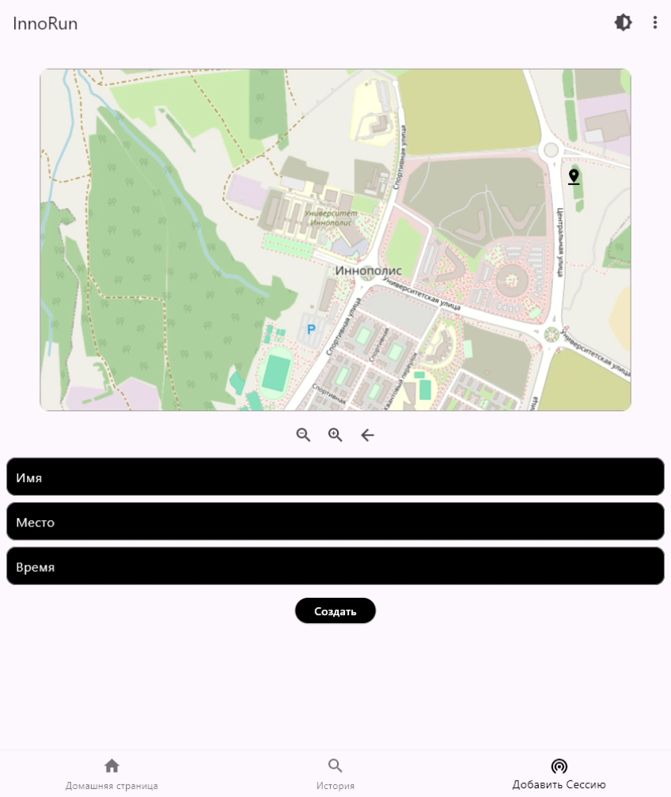
Localization

Slide 9
The Challenges & conflicts
The first issue that occurred during the development is git conflicts in the code. To avoid mentioned problem and resolve it we used the following methods
Clear code review parameters
Use different branches
Merge pull requests together, to discuss occurred issues
The second problem was the conflict in planning entire project. We planned to parse data from webserver, but deploy it somewhere for open source was to difficult
Host server usually not for free
Complex parsing the data that related to map

Slide 10

Link to the deployed product
LINK

